Slide 1

WEL COME TO DIGITAL CLASS

Slide 2
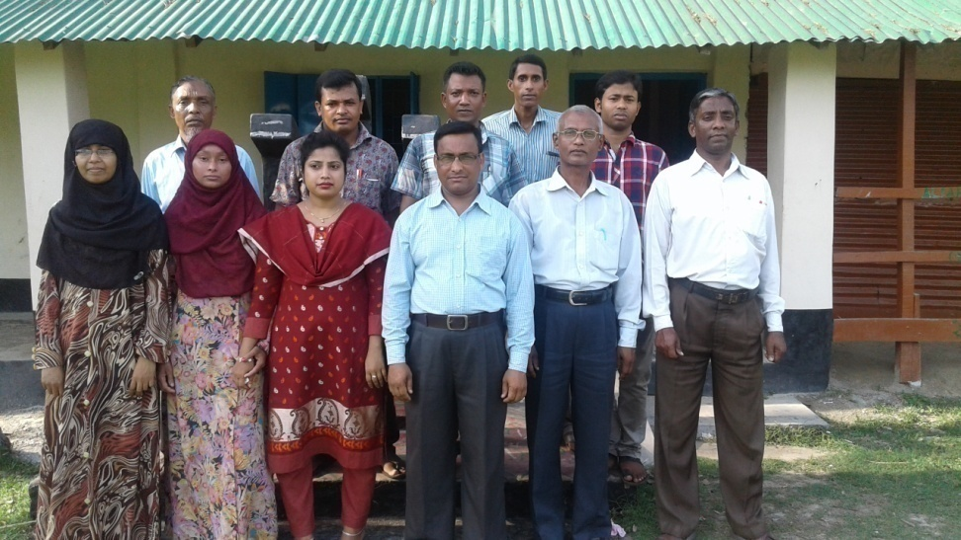
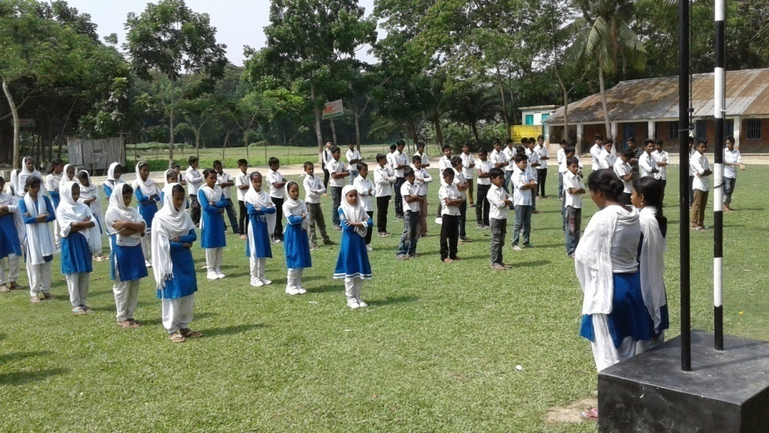
SCHOOL IDENTITY

Slide 3
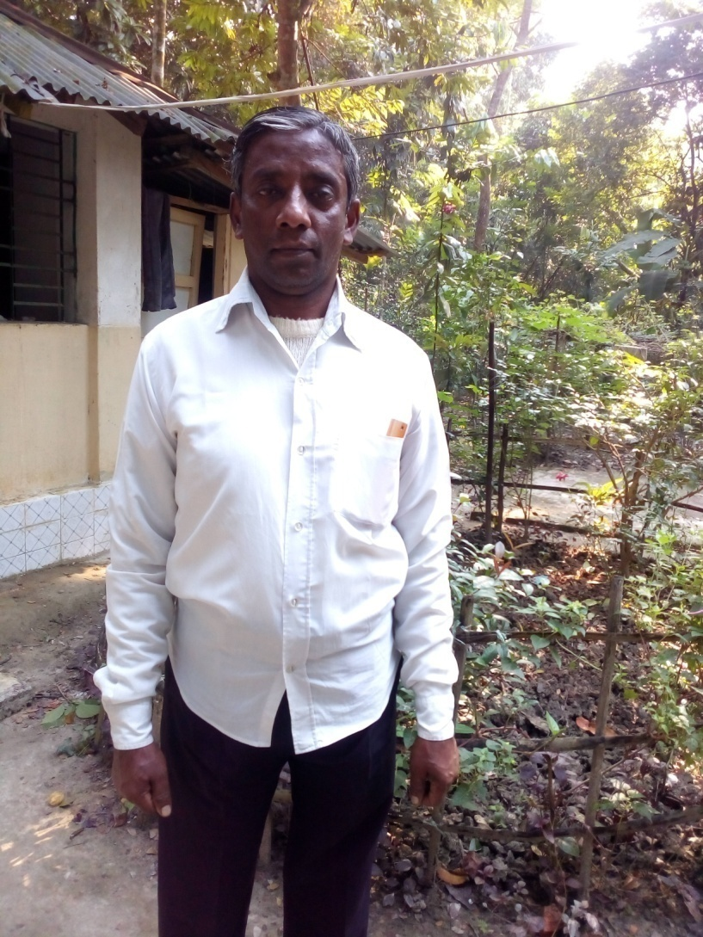
TEACHER IDENTITY
Shanti Ranjan Chakraborty
Assistant Teacher
Shanuher M A High School
Ujirpur, Barisal.
Mobile-01715485221
Email-shanti02266@gmail.com

Slide 4
Lesson Introduction
Class-vi-X
Subject:English First paper
(Dialogue)
Time: 50min
Date:10/09/2017

Slide 5
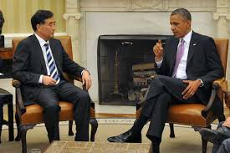
What are they doing?
Dialogue

Slide 6
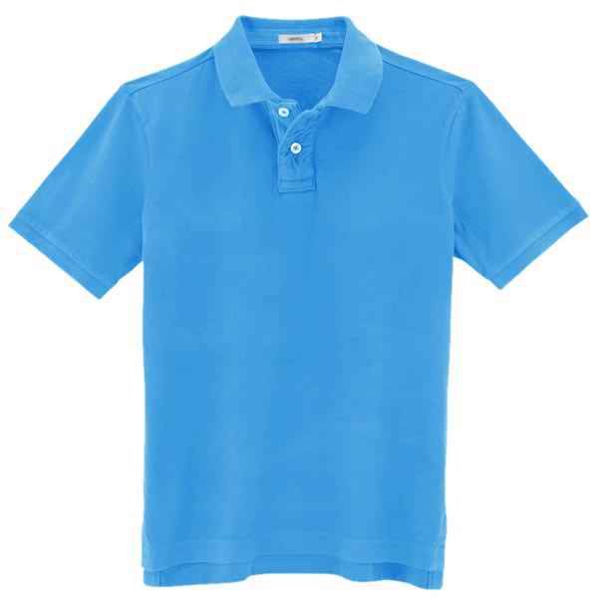
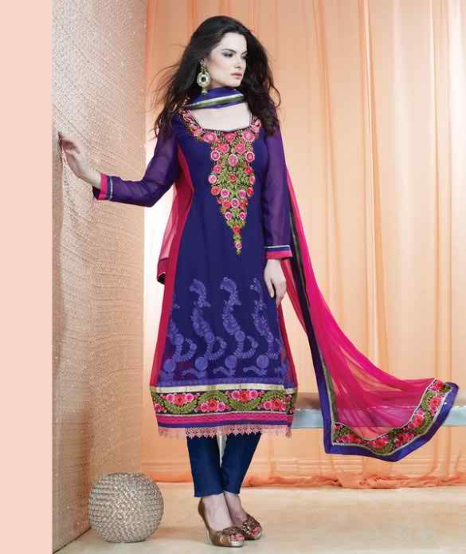
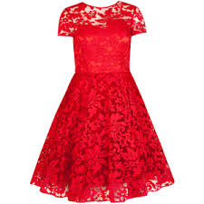
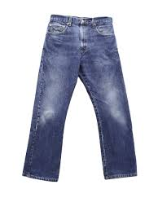
Look at the pictures and discuss

Slide 7
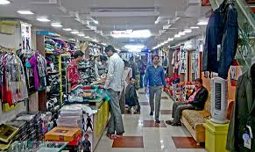
What do you see the picture?

Slide 8
Todays lesson is “Dialogue” about buying clothes

Slide 9
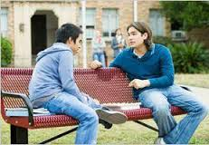
Tanvir: Have you ever been to a clothe shop?
Tomal: Yes. I have recently been to a clothe shop to buy a shirt for me .

Slide 10
Tanvir: very nice . Did you go by
yourself?
Tomal: Oh, no. I went with my mother. She took me to choose my clothes.

Slide 11
Tanvir: what did you see there?
Tomal: There I saw clothes of different colors and sizes. It was really amazing.

Slide 12
Tanvir: what is your favorite color?
Tomal: My favorite color is maroon.

Slide 13
Tanvir: Thank you for your discussion.
Tomal: welcome.

Slide 14
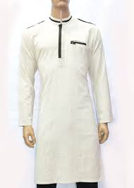
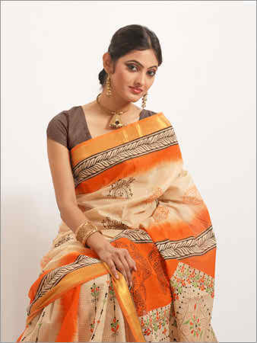
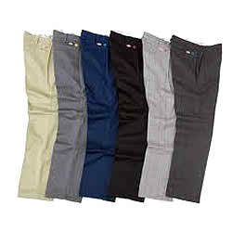
Identify the dresses:

Slide 15
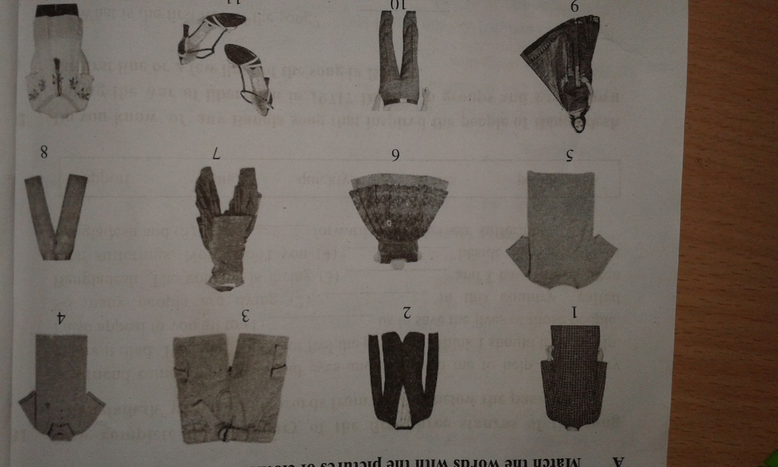
Look at the pictures Practice asking & answering their name, brand, size & price.

Slide 16
Pair work complete the sentences-
1. Excuse me , where are the--------? (polo shirts/ trousers/ socks/shoes)
2. Do you have the kinds without---? (buttons/lace/hooks)
3. Do you have these in a different---? (color/size/design)
4. How much is /are --------? (this/these/the shirt/the trousers)

Slide 17
Answer slide
1 a. Excuse me where are the polo shirts /the trousers / the socks ?
2. a. Do you have the kinds without lace / buttons /hooks ?
3. a. Do you have these in a different size / colour /design ?
4. a. How much is this these/ the shirt / these socks /the trousers ?

Slide 18
Home Work
Write a dialogue between a buyer & a seller on buying a Panjabi.

Slide 19

Good Bye

Slide 20
Learning out comes
After completing the lesson students will be able to-
1. Read and understand conversations.
2.Ask and answer questions on dressing.
3.complete sentence.

